Slide 1
Chapter 1: Introduction

Slide 2
Chapter 1: Introduction
What Operating Systems Do
Computer-System Organization
Computer-System Architecture
Operating-System Operations
Resource Management
Security and Protection
Virtualization

Slide 3
What is an Operating System?
A program that acts as an intermediary between a user of a computer and the computer hardware
Operating system goals:
Execute user programs and make solving user problems easier
Make the computer system convenient to use
Use the computer hardware in an efficient manner

Slide 4
Computer System Structure
Computer system can be divided into four components:
Hardware – provides basic computing resources
CPU, memory, I/O devices
Operating system
Controls and coordinates use of hardware among various applications and users
Application programs – define the ways in which the system resources are used to solve the computing problems of the users
Word processors, compilers, web browsers, database systems, video games
Users
People, machines, other computers

Slide 5
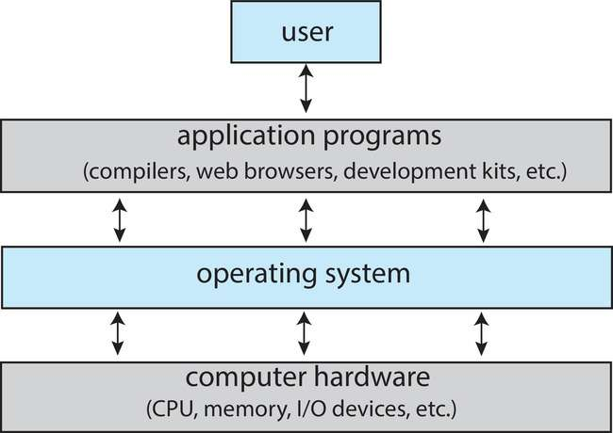
Abstract View of Components of Computer

Slide 6
What Operating Systems Do
Depends on the point of view
Users want convenience, ease of use and good performance
Don’t care about resource utilization
But shared computer such as mainframe or minicomputer must keep all users happy
Operating system is a resource allocator and control program making efficient use of HW and managing execution of user programs
Users of dedicate systems such as workstations have dedicated resources but frequently use shared resources from servers
Mobile devices like smartphones and tables are resource poor, optimized for usability and battery life
Mobile user interfaces such as touch screens, voice recognition
Some computers have little or no user interface, such as embedded computers in devices and automobiles
Run primarily without user intervention

Slide 7
Overview of Computer System Structure

Slide 8
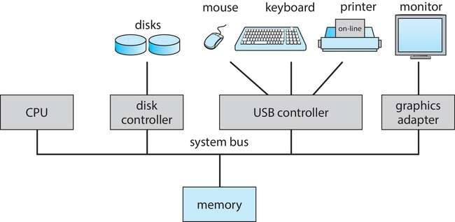
Computer System Organization
Computer-system operation
One or more CPUs, device controllers connect through common bus providing access to shared memory
Concurrent execution of CPUs and devices competing for memory cycles

Slide 9
Computer-System Operation
I/O devices and the CPU can execute concurrently
Each device controller is in charge of a particular device type
Each device controller has a local buffer
Each device controller type has an operating system device driver to manage it
CPU moves data from/to main memory to/from local buffers
I/O is from the device to local buffer of controller
Device controller informs CPU that it has finished its operation by causing an interrupt

Slide 10
Operating-System Operations
Bootstrap program – simple code to initialize the system, load the kernel
Kernel loads
Starts system daemons (services provided outside of the kernel)
Kernel interrupt driven (hardware and software)
Hardware interrupt by one of the devices
Software interrupt (exception or trap):
Software error (e.g., division by zero)
Request for operating system service – system call
Other process problems include infinite loop, processes modifying each other or the operating system

Slide 11
Multiprogramming (Batch system)
Single user cannot always keep CPU and I/O devices busy
Multiprogramming organizes jobs (code and data) so CPU always has one to execute
A subset of total jobs in system is kept in memory
One job selected and run via job scheduling
When job has to wait (for I/O for example), OS switches to another job

Slide 12
Multitasking (Timesharing)
A logical extension of Batch systems– the CPU switches jobs so frequently that users can interact with each job while it is running, creating interactive computing
Response time should be < 1 second
Each user has at least one program executing in memory  process
If several jobs ready to run at the same time  CPU scheduling
If processes don’t fit in memory, swapping moves them in and out to run
Virtual memory allows execution of processes not completely in memory

Slide 13
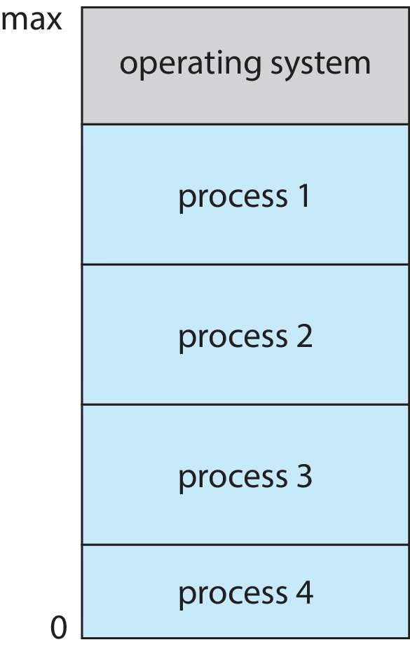
Memory Layout for Multiprogrammed System

Slide 14
Dual-mode Operation
Dual-mode operation allows OS to protect itself and other system components
User mode and kernel mode
Mode bit provided by hardware
Provides ability to distinguish when system is running user code or kernel code.
When a user is running  mode bit is “user”
When kernel code is executing  mode bit is “kernel”
How do we guarantee that user does not explicitly set the mode bit to “kernel”?
System call changes mode to kernel, return from call resets it to user
Some instructions designated as privileged, only executable in kernel mode

Slide 15
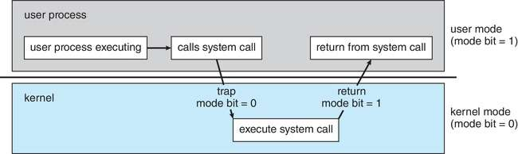
Transition from User to Kernel Mode

Slide 16
Virtualization
Allows operating systems to run applications within other OSes
Vast and growing industry
Emulation used when source CPU type different from target type (i.e. PowerPC to Intel x86)
Generally slowest method
When computer language not compiled to native code – Interpretation
Virtualization – OS natively compiled for CPU, running guest OSes also natively compiled
Consider VMware running WinXP guests, each running applications, all on native WinXP host OS
VMM (virtual machine Manager) provides virtualization services

Slide 17
Virtualization (cont.)
Use cases involve laptops and desktops running multiple OSes for exploration or compatibility
Apple laptop running Mac OS X host, Windows as a guest
Developing apps for multiple OSes without having multiple systems
Quality assurance testing applications without having multiple systems
Executing and managing compute environments within data centers
VMM can run natively, in which case they are also the host
There is no general-purpose host then (VMware ESX and Citrix XenServer)

Slide 18
Computing Environments - Virtualization

Slide 19
Chapter 1(Cont’d): Operating-System Services

Slide 20
Operating System Services
Operating systems provide an environment for execution of programs and services to programs and users
One set of operating-system services provides functions that are helpful to the user:
User interface - Almost all operating systems have a user interface (UI).
Varies between Command-Line (CLI), Graphics User Interface (GUI), touch-screen, Batch
Program execution - The system must be able to load a program into memory and to run that program, end execution, either normally or abnormally (indicating error)
I/O operations - A running program may require I/O, which may involve a file or an I/O device
File-system manipulation - The file system is of particular interest. Programs need to read and write files and directories, create and delete them, search them, list file Information, permission management.

Slide 21
Operating System Services (Cont.)
One set of operating-system services provides functions that are helpful to the user (Cont.):
Communications – Processes may exchange information, on the same computer or between computers over a network
Communications may be via shared memory or through message passing (packets moved by the OS)
Error detection – OS needs to be constantly aware of possible errors
May occur in the CPU and memory hardware, in I/O devices, in user program
For each type of error, OS should take the appropriate action to ensure correct and consistent computing
Debugging facilities can greatly enhance the user’s and programmer’s abilities to efficiently use the system

Slide 22
Operating System Services (Cont.)
Another set of OS functions exists for ensuring the efficient operation of the system itself via resource sharing
Resource allocation - When multiple users or multiple jobs running concurrently, resources must be allocated to each of them
Many types of resources - CPU cycles, main memory, file storage, I/O devices.
Logging - To keep track of which users use how much and what kinds of computer resources
Protection and security - The owners of information stored in a multiuser or networked computer system may want to control use of that information, concurrent processes should not interfere with each other
Protection involves ensuring that all access to system resources is controlled
Security of the system from outsiders requires user authentication, extends to defending external I/O devices from invalid access attempts

Slide 23
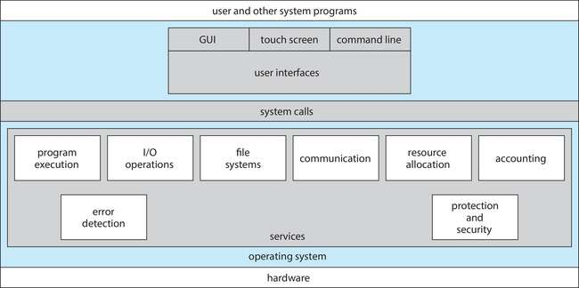
A View of Operating System Services

Slide 24
Operating System Structure
General-purpose OS is very large program
Various ways to structure ones
Simple structure – MS-DOS
More complex – UNIX
Layered – an abstraction
Microkernel – Mach

Slide 25
Monolithic Structure – Original UNIX
UNIX – limited by hardware functionality, the original UNIX operating system had limited structuring.
The UNIX OS consists of two separable parts
Systems programs
The kernel
Consists of everything below the system-call interface and above the physical hardware
Provides the file system, CPU scheduling, memory management, and other operating-system functions; a large number of functions for one level

Slide 26
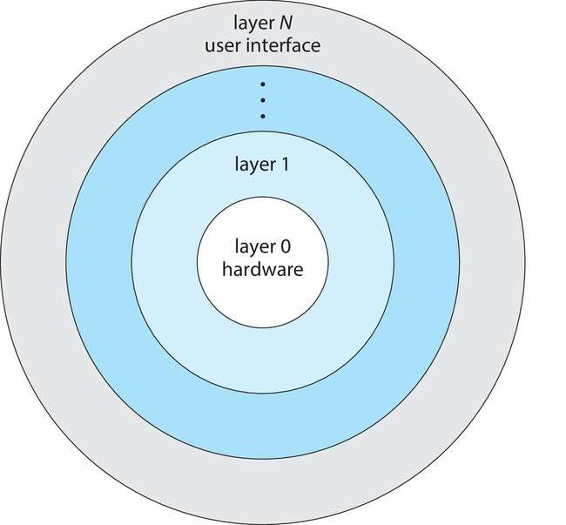
Layered Approach
The operating system is divided into a number of layers (levels), each built on top of lower layers. The bottom layer (layer 0), is the hardware; the highest (layer N) is the user interface.
With modularity, layers are selected such that each uses functions (operations) and services of only lower-level layers

Slide 27
Microkernels
Moves as much from the kernel into user space
Mach is an example of microkernel
Mac OS X kernel (Darwin) partly based on Mach
Communication takes place between user modules using message passing
Benefits:
Easier to extend a microkernel
Easier to port the operating system to new architectures
More reliable (less code is running in kernel mode)
More secure
Detriments:
Performance overhead of user space to kernel space communication

Slide 28
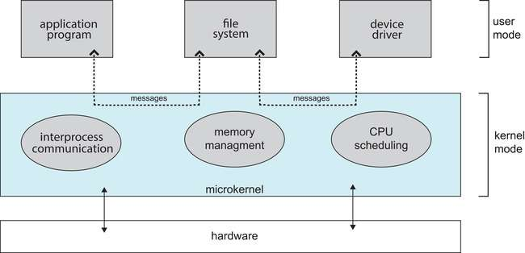
Microkernel System Structure

Slide 29
Chapter 2: Processes & Threads

Slide 30
Outline
Process Concept
Process Scheduling
Operations on Processes

Slide 31
Process Concept
An operating system executes a variety of programs that run as a process.
Process – a program in execution; process execution must progress in sequential fashion. No parallel execution of instructions of a single process
Multiple parts
The program code, also called text section
Current activity including program counter, processor registers
Stack containing temporary data
Function parameters, return addresses, local variables
Data section containing global variables
Heap containing memory dynamically allocated during run time

Slide 32
Process Concept (Cont.)
Program is passive entity stored on disk (executable file); process is active
Program becomes process when an executable file is loaded into memory
Execution of program started via GUI mouse clicks, command line entry of its name, etc.
One program can be several processes
Consider multiple users executing the same program

Slide 33
Process State
As a process executes, it changes state
New: The process is being created
Running: Instructions are being executed
Waiting: The process is waiting for some event to occur
Ready: The process is waiting to be assigned to a processor
Terminated: The process has finished execution

Slide 34
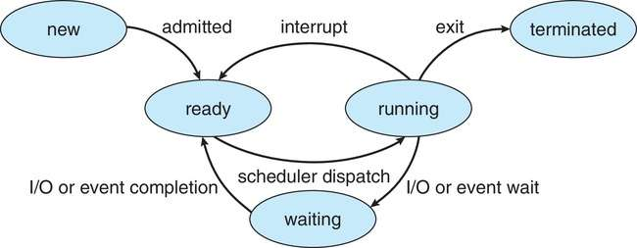
Diagram of Process State

Slide 35
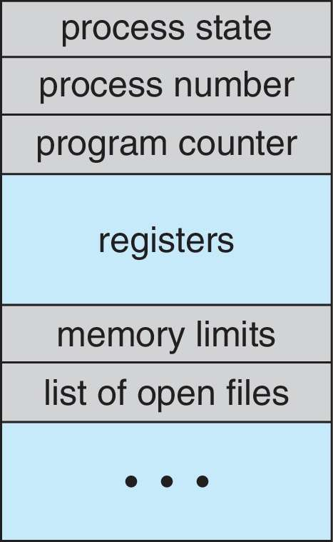
Process Control Block (PCB)
Information associated with each process(also called task control block)
Process state – running, waiting, etc.
Program counter – location of instruction to next execute
CPU registers – contents of all process-centric registers
CPU scheduling information- priorities, scheduling queue pointers
Memory-management information – memory allocated to the process
Accounting information – CPU used, clock time elapsed since start, time limits
I/O status information – I/O devices allocated to process, list of open files

Slide 36
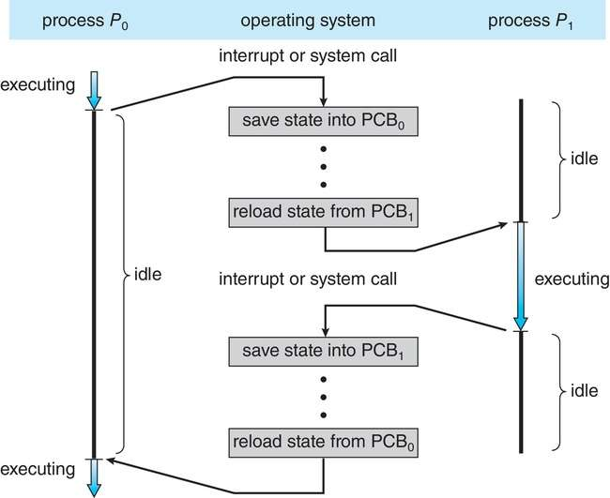
CPU Switch From Process to Process
A context switch occurs when the CPU switches from one process to another.

Slide 37
Context Switch
When CPU switches to another process, the system must save the state of the old process and load the saved state for the new process via a context switch
Context of a process represented in the PCB
Context-switch time is pure overhead; the system does no useful work while switching
The more complex the OS and the PCB ➔ the longer the context switch
Time dependent on hardware support
Some hardware provides multiple sets of registers per CPU ➔ multiple contexts loaded at once

Slide 38
Operations on Processes
System must provide mechanisms for:
Process creation
Process termination

Slide 39
Process Creation
Parent process create children processes, which, in turn create other processes, forming a tree of processes
Generally, process identified and managed via a process identifier (pid)
Resource sharing options
Parent and children share all resources
Children share subset of parent’s resources
Parent and child share no resources
Execution options
Parent and children execute concurrently
Parent waits until children terminate

Slide 40
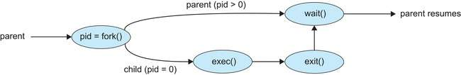
Process Creation (Cont.)
Address space
Child duplicate of parent
Child has a program loaded into it
UNIX examples
fork() system call creates new process
exec() system call used after a fork() to replace the process’ memory space with a new program
Parent process calls wait()waiting for the child to terminate

Slide 41
Process Termination
Process executes last statement and then asks the operating system to delete it using the exit() system call.
Returns status data from child to parent (via wait())
Process’ resources are deallocated by operating system
Parent may terminate the execution of children processes using the abort() system call. Some reasons for doing so:
Child has exceeded allocated resources
Task assigned to child is no longer required
The parent is exiting, and the operating systems does not allow a child to continue if its parent terminates

Slide 42
Process Termination
Some operating systems do not allow child to exists if its parent has terminated. If a process terminates, then all its children must also be terminated.
cascading termination. All children, grandchildren, etc., are terminated.
The termination is initiated by the operating system.
The parent process may wait for termination of a child process by using the wait()system call. The call returns status information and the pid of the terminated process
pid = wait(&status);
If no parent waiting (did not invoke wait()) process is a zombie
If parent terminated without invoking wait(), process is an orphan

Slide 43
Chapter 2 (Cont’d): Threads

Slide 44
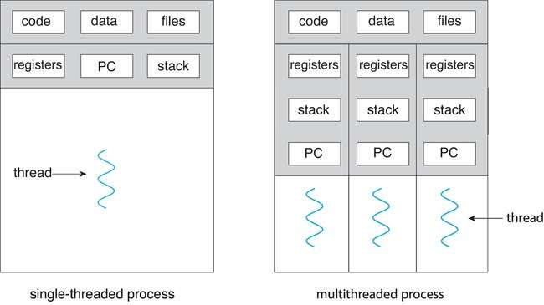
Single and Multithreaded Processes

Slide 45
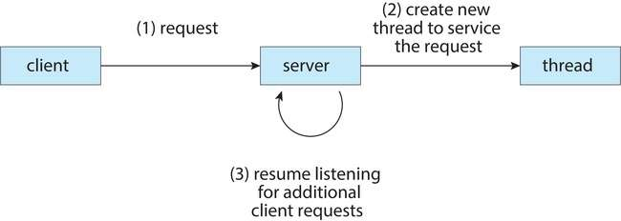
Multithreaded Server Architecture

Slide 46
Benefits
Responsiveness – may allow continued execution if part of process is blocked, especially important for user interfaces
Resource Sharing – threads share resources of process, easier than shared memory or message passing
Economy – cheaper than process creation, thread switching lower overhead than context switching
Scalability – process can take advantage of multicore architectures

Slide 47
Multicore Programming
Multicore or multiprocessor systems puts pressure on programmers, challenges include:
Dividing activities
Balance
Data splitting
Data dependency
Testing and debugging
Parallelism implies a system can perform more than one task simultaneously
Concurrency supports more than one task making progress
Single processor / core, scheduler providing concurrency

Slide 48

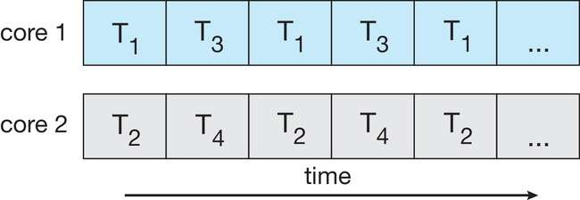
Concurrency vs. Parallelism
Concurrent execution on single-core system:
Parallelism on a multi-core system:

Slide 49
User Threads and Kernel Threads
User threads - management done by user-level threads library
Three primary thread libraries:
POSIX Pthreads
Windows threads
Java threads
Kernel threads - Supported by the Kernel
Examples – virtually all general-purpose operating systems, including:
Windows
Linux
Mac OS X
iOS
Android

Slide 50
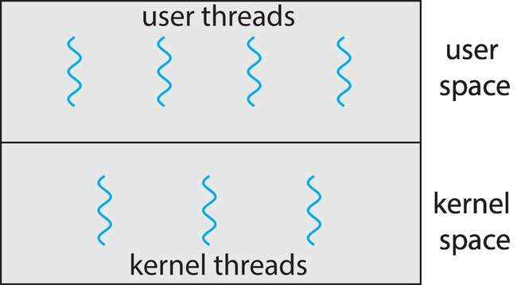
User and Kernel Threads

Slide 51
Multithreading Models
Many-to-One
One-to-One
Many-to-Many

Slide 52
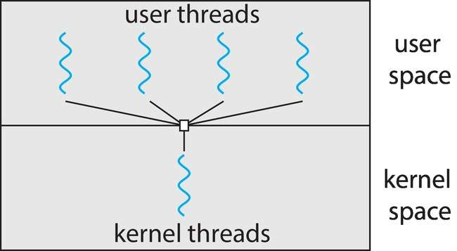
Many-to-One
Many user-level threads mapped to single kernel thread
One thread blocking causes all to block
Multiple threads may not run in parallel on multicore system because only one may be in kernel at a time
Few systems currently use this model
Examples:
Solaris Green Threads
GNU Portable Threads

Slide 53
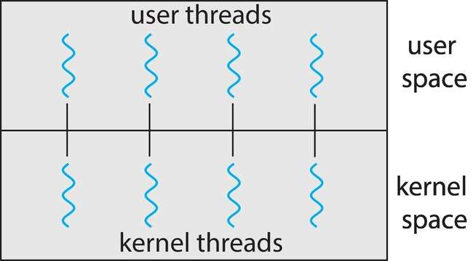
One-to-One
Each user-level thread maps to kernel thread
Creating a user-level thread creates a kernel thread
More concurrency than many-to-one
Number of threads per process sometimes restricted due to overhead
Examples
Windows
Linux

Slide 54
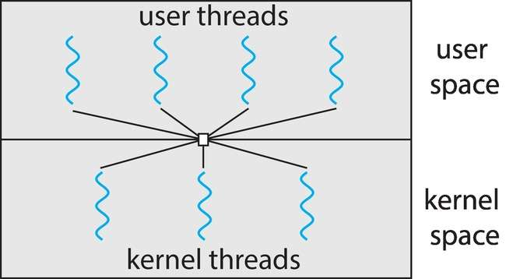
Many-to-Many Model
Allows many user level threads to be mapped to many kernel threads
Allows the operating system to create a sufficient number of kernel threads
Windows with the ThreadFiber package
Otherwise not very common

Slide 55
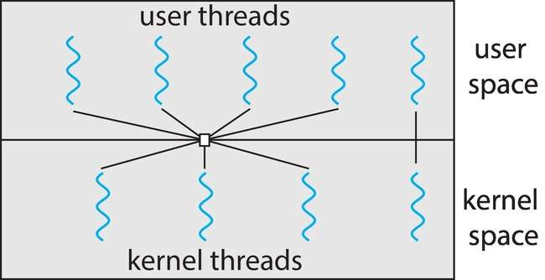
Two-level Model
Similar to M:M, except that it allows a user thread to be bound to kernel thread

Slide 56
Thread Libraries
Thread library provides programmer with API for creating and managing threads
Two primary ways of implementing
Library entirely in user space
Kernel-level library supported by the OS

Slide 57
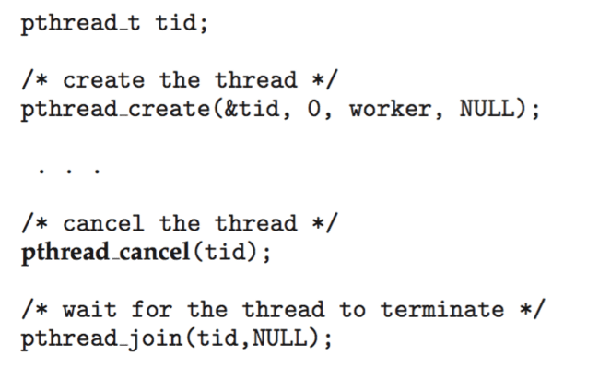
Thread Cancellation
Terminating a thread before it has finished
Thread to be canceled is target thread
Two general approaches:
Asynchronous cancellation terminates the target thread immediately
Deferred cancellation allows the target thread to periodically check if it should be cancelled
Pthread code to create and cancel a thread:

Slide 58
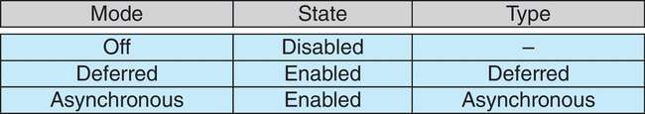
Thread Cancellation (Cont.)
Invoking thread cancellation requests cancellation, but actual cancellation depends on thread state
If thread has cancellation disabled, cancellation remains pending until thread enables it
Default type is deferred
Cancellation only occurs when thread reaches cancellation point
i.e., pthread_testcancel()
Then cleanup handler is invoked
On Linux systems, thread cancellation is handled through signals

Slide 59
Chapter 3: CPU Scheduling

Slide 60
Outline
Basic Concepts
Scheduling Criteria
Scheduling Algorithms
Multi-Processor Scheduling
Real-Time CPU Scheduling

Slide 61
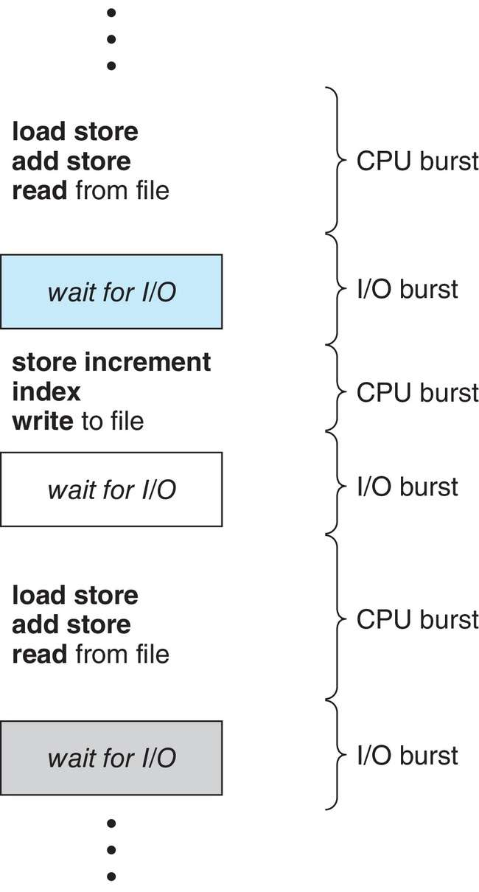
Basic Concepts
Maximum CPU utilization obtained with multiprogramming
CPU–I/O Burst Cycle – Process execution consists of a cycle of CPU execution and I/O wait
CPU burst followed by I/O burst
CPU burst distribution is of main concern

Slide 62
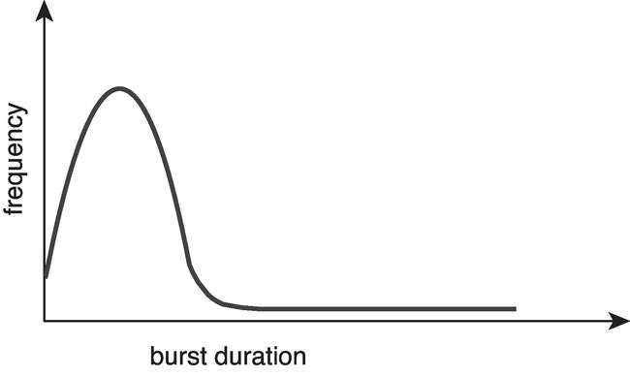
Histogram of CPU-burst Times
Large number of short bursts
Small number of longer bursts

Slide 63
CPU Scheduler
The CPU scheduler selects from among the processes in ready queue, and allocates a CPU core to one of them
Queue may be ordered in various ways
CPU scheduling decisions may take place when a process:
1. Switches from running to waiting state
2. Switches from running to ready state
3. Switches from waiting to ready
Terminates
For situations 1 and 4, there is no choice in terms of scheduling. A new process (if one exists in the ready queue) must be selected for execution.
For situations 2 and 3, however, there is a choice.

Slide 64
Preemptive and Nonpreemptive Scheduling
When scheduling takes place only under circumstances 1 and 4, the scheduling scheme is nonpreemptive.
Otherwise, it is preemptive.
Under Nonpreemptive scheduling, once the CPU has been allocated to a process, the process keeps the CPU until it releases it either by terminating or by switching to the waiting state.
Virtually all modern operating systems including Windows, MacOS, Linux, and UNIX use preemptive scheduling algorithms.

Slide 65
Preemptive Scheduling and Race Conditions
Preemptive scheduling can result in race conditions when data are shared among several processes.
Consider the case of two processes that share data. While one process is updating the data, it is preempted so that the second process can run. The second process then tries to read the data, which are in an inconsistent state.
This issue will be explored in detail in Chapter 6.

Slide 66
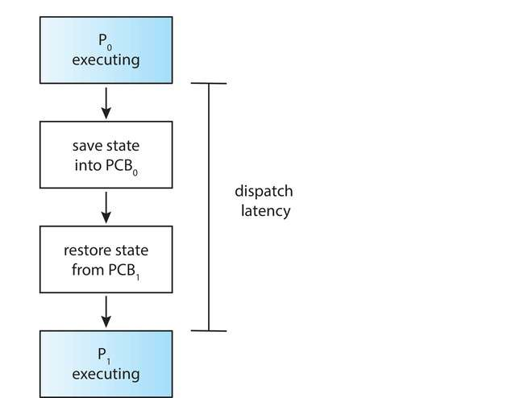
Dispatcher
Dispatcher module gives control of the CPU to the process selected by the CPU scheduler; this involves:
Switching context
Switching to user mode
Jumping to the proper location in the user program to restart that program
Dispatch latency – time it takes for the dispatcher to stop one process and start another running

Slide 67
Scheduling Criteria
CPU utilization – keep the CPU as busy as possible
Throughput – # of processes that complete their execution per time unit
Turnaround time – amount of time to execute a particular process
Waiting time – amount of time a process has been waiting in the ready queue
Response time – amount of time it takes from when a request was submitted until the first response is produced.

Slide 68
Scheduling Algorithm Optimization Criteria
Max CPU utilization
Max throughput
Min turnaround time
Min waiting time
Min response time

Slide 69
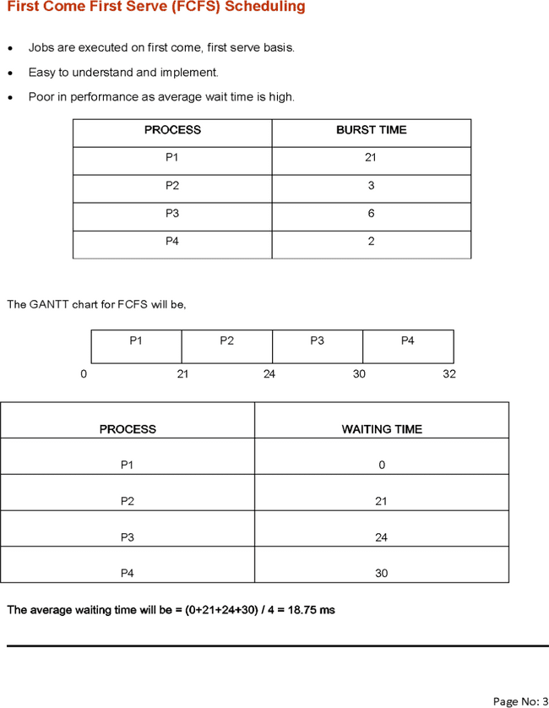
First- Come, First-Served (FCFS) Scheduling
Process Burst Time
P₁ 24
P₂ 3
P₃ 3
Suppose that the processes arrive in the order: P₁ , P₂ , P₃ The Gantt Chart for the schedule is:
Waiting time for P₁ = 0; P₂ = 24; P₃ = 27
Average waiting time: (0 + 24 + 27)/3 = 17

Slide 70
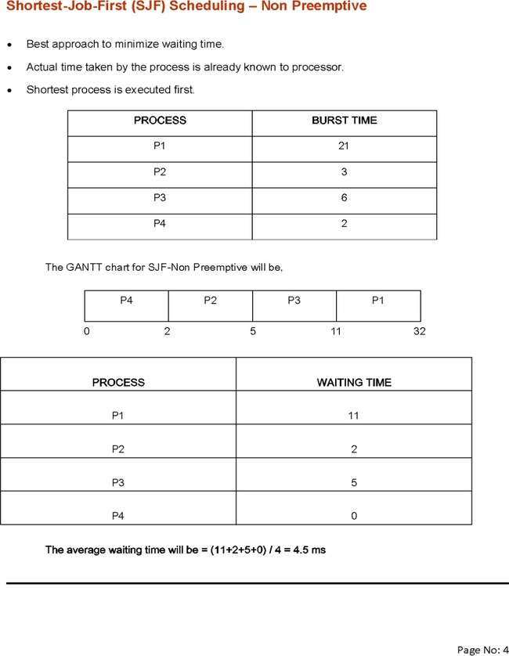
Shortest-Job-First (SJF) Scheduling
Associate with each process the length of its next CPU burst
Use these lengths to schedule the process with the shortest time
SJF is optimal – gives minimum average waiting time for a given set of processes
Preemptive version called shortest-remaining-time-first
How do we determine the length of the next CPU burst?
Could ask the user
Estimate

Slide 71
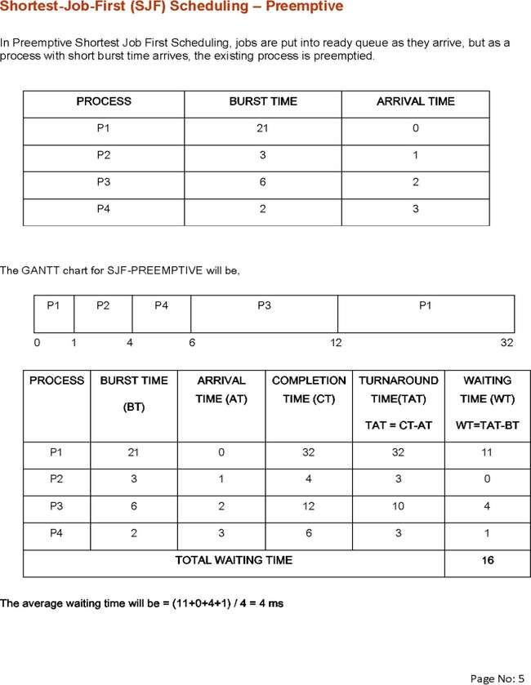
Example of SJF(Preemptive)
Process Burst Time
P₁ 6
P₂ 8
P₃ 7
P₄ 3
SJF scheduling chart
Average waiting time = (3 + 16 + 9 + 0) / 4 = 7

Slide 72
Round Robin (RR)
A fixed time is allocated to each process, called quantum for each execution
Only a process is executed for given time period that process is preempted and other process executes for given time period
Context switching is used to save states of preempted processes.
Assume time quantum as 5ms
Gantt Chart
0 5 8 13 15 20 21 32
Process | Burst time
P1 | 21
P2 | 3
P3 | 6
P4 | 2
P1 | P2 | P3 | P4 | P1 | P3 | P1
Process | Waiting Time = Completion Time – Burst time
P1 | =(32-21)➔11
P2 | =(8-3)➔5
P3 | =(21-6)➔15
P4 | =(15-2)➔13
Total Waiting Time | =44
Average Waiting Time | =44/4 ➔11 ms

Slide 73
Priority Scheduling
Priority is assigned for each process.
Process with highest priority is executed first and so on.
Process with same priority are executed in FCFS manner.
Priority can be decided on memory requirements, time requirements or any other resource requirements
Gantt Chart
0 3 24 26 32
Waiting Time
Total Wt = 53
AWT =53/4 = 18.75ms
Proces | Burst Time | Priority
P1 | 21 | 2
P2 | 3 | 1 (Highest)
P3 | 6 | 4 (Lowest
P4 | 2 | 3
P2 | P1 | P4 | P3
Process | Waiting Time
P1 | 3
P2 | 0
P3 | 26
P4 | 24

Slide 74
Multilevel Queue
The ready queue consists of multiple queues
Multilevel queue scheduler defined by the following parameters:
Number of queues
Scheduling algorithms for each queue
Method used to determine which queue a process will enter when that process needs service
Scheduling among the queues

Slide 75
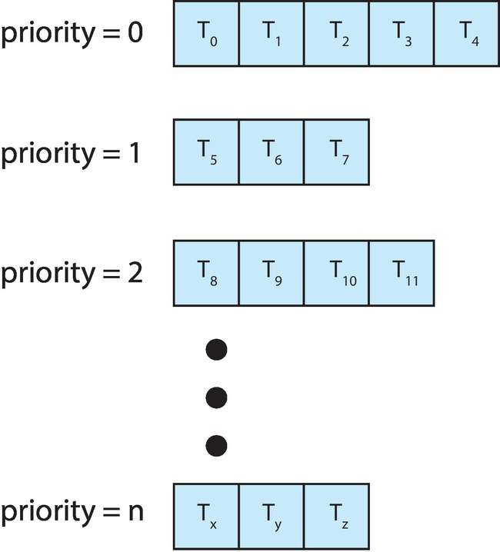
Multilevel Queue
With priority scheduling, have separate queues for each priority.
Schedule the process in the highest-priority queue!

Slide 76
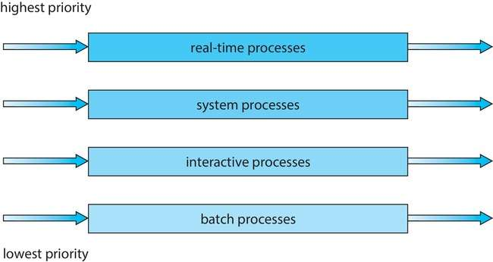
Multilevel Queue
Prioritization based upon process type

Slide 77
Multiple-Processor Scheduling
CPU scheduling more complex when multiple CPUs are available
Multiprocess may be any one of the following architectures:
Multicore CPUs
Multithreaded cores
NUMA systems
Heterogeneous multiprocessing

Slide 78
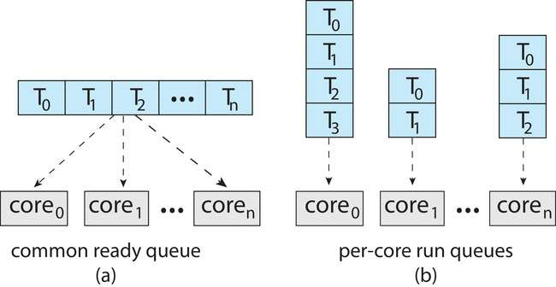
Multiple-Processor Scheduling
Symmetric multiprocessing (SMP) is where each processor is self scheduling.
All threads may be in a common ready queue (a)
Each processor may have its own private queue of threads (b)

Slide 79
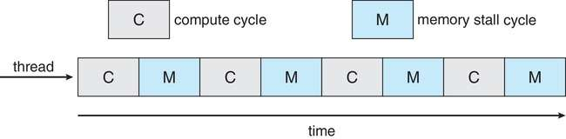
Multicore Processors
Recent trend to place multiple processor cores on same physical chip
Faster and consumes less power
Multiple threads per core also growing
Takes advantage of memory stall to make progress on another thread while memory retrieve happens
Figure

Slide 80
Real-Time CPU Scheduling
Can present obvious challenges
Soft real-time systems – Critical real-time tasks have the highest priority, but no guarantee as to when tasks will be scheduled
Hard real-time systems – task must be serviced by its deadline

Slide 81
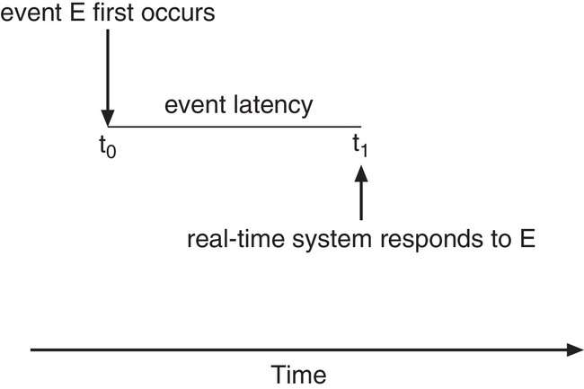
Real-Time CPU Scheduling
Event latency – the amount of time that elapses from when an event occurs to when it is serviced.
Two types of latencies affect performance
Interrupt latency – time from arrival of interrupt to start of routine that services interrupt
Dispatch latency – time for schedule to take current process off CPU and switch to another

Slide 82
Chapter 4: Synchronization & Deadlocks

Slide 83
Outline
Background
The Critical-Section Problem
Mutex Locks
Semaphores
Monitors

Slide 84
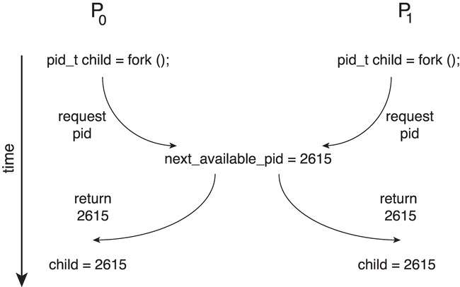
Race Condition
Processes P₀ and P₁ are creating child processes using the fork() system call
Race condition on kernel variable next_available_pid which represents the next available process identifier (pid)
Unless there is a mechanism to prevent P₀ and P₁ from accessing the variable next_available_pid the same pid could be assigned to two different processes!

Slide 85
Critical Section Problem
Consider system of n processes {p₀, p₁, … p_{n-1}}
Each process has critical section segment of code
Process may be changing common variables, updating table, writing file, etc.
When one process in critical section, no other may be in its critical section
Critical section problem is to design protocol to solve this
Each process must ask permission to enter critical section in entry section, may follow critical section with exit section, then remainder section

Slide 86
Critical-Section Problem (Cont.)
Requirements for solution to critical-section problem
Mutual Exclusion - If process P_{i} is executing in its critical section, then no other processes can be executing in their critical sections
Progress - If no process is executing in its critical section and there exist some processes that wish to enter their critical section, then the selection of the process that will enter the critical section next cannot be postponed indefinitely
Bounded Waiting - A bound must exist on the number of times that other processes are allowed to enter their critical sections after a process has made a request to enter its critical section and before that request is granted
Assume that each process executes at a nonzero speed
No assumption concerning relative speed of the n processes

Slide 87
Mutex Locks
Previous solutions are complicated and generally inaccessible to application programmers
OS designers build software tools to solve critical section problem
Simplest is mutex lock
Boolean variable indicating if lock is available or not
Protect a critical section by
First acquire() a lock
Then release() the lock
Calls to acquire() and release() must be atomic
Usually implemented via hardware atomic instructions such as compare-and-swap.
But this solution requires busy waiting
This lock therefore called a spinlock

Slide 88
Semaphore
Synchronization tool that provides more sophisticated ways (than Mutex locks) for processes to synchronize their activities.
Semaphore S – integer variable
Can only be accessed via two indivisible (atomic) operations
wait() and signal()
Originally called P() and V()
Definition of the wait() operation
wait(S) {
while (S <= 0)
; // busy wait
S--;
}
Definition of the signal() operation
signal(S) {
S++;
}

Slide 89
Semaphore (Cont.)
Counting semaphore – integer value can range over an unrestricted domain
Binary semaphore – integer value can range only between 0 and 1
Same as a mutex lock
Can implement a counting semaphore S as a binary semaphore
With semaphores we can solve various synchronization problems

Slide 90
Chapter 4 (Cont’d): Synchronization Examples

Slide 91
Classical Problems of Synchronization
Classical problems used to test newly-proposed synchronization schemes
Bounded-Buffer Problem
Readers and Writers Problem
Dining-Philosophers Problem

Slide 92
Bounded-Buffer Problem
n buffers, each can hold one item
Semaphore mutex initialized to the value 1
Semaphore full initialized to the value 0
Semaphore empty initialized to the value n

Slide 93
Readers-Writers Problem
A data set is shared among a number of concurrent processes
Readers – only read the data set; they do not perform any updates
Writers – can both read and write
Problem – allow multiple readers to read at the same time
Only one single writer can access the shared data at the same time
Several variations of how readers and writers are considered – all involve some form of priorities

Slide 94
Readers-Writers Problem (Cont.)
Shared Data
Data set
Semaphore rw_mutex initialized to 1
Semaphore mutex initialized to 1
Integer read_count initialized to 0

Slide 95
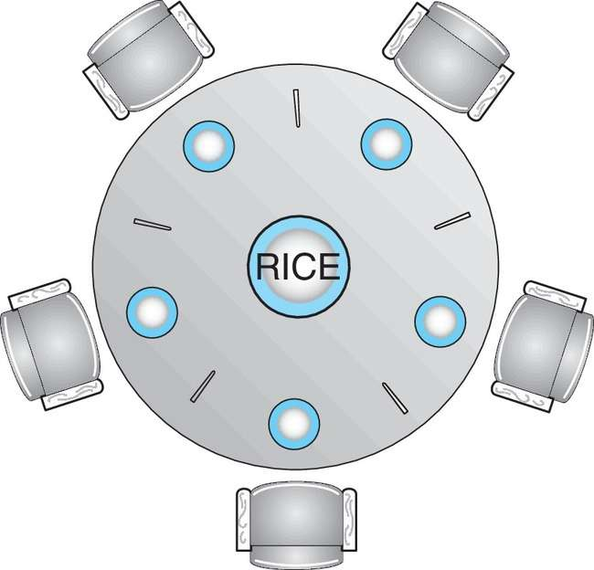
Dining-Philosophers Problem
N philosophers’ sit at a round table with a bowel of rice in the middle.
They spend their lives alternating thinking and eating.
They do not interact with their neighbors.
Occasionally try to pick up 2 chopsticks (one at a time) to eat from bowl
Need both to eat, then release both when done
In the case of 5 philosophers, the shared data
Bowl of rice (data set)
Semaphore chopstick [5] initialized to 1

Slide 96
Chapter 4 (Cont’d): Deadlocks

Slide 97
System Model
System consists of resources
Resource types R₁, R₂, . . ., R_{m}
CPU cycles, memory space, I/O devices
Each resource type R_{i} has W_{i} instances.
Each process utilizes a resource as follows:
request
use
release

Slide 98
Deadlock Characterization
Deadlock can arise if four conditions hold simultaneously.
Mutual exclusion: only one thread at a time can use a resource
Hold and wait: a thread holding at least one resource is waiting to acquire additional resources held by other threads
No preemption: a resource can be released only voluntarily by the thread holding it, after that thread has completed its task
Circular wait: there exists a set {T₀, T₁, …, T_{n}} of waiting threads such that T₀ is waiting for a resource that is held by T₁, T₁ is waiting for a resource that is held by T₂, …, T_{n–1} is waiting for a resource that is held by T_{n}, and T_{n} is waiting for a resource that is held by T₀.

Slide 99
Resource-Allocation Graph
A set of vertices V and a set of edges E.
V is partitioned into two types:
T = {T₁, T₂, …, T_{n}}, the set consisting of all the threads in the system.
R = {R₁, R₂, …, R_{m}}, the set consisting of all resource types in the system
request edge – directed edge T_{i} → R_{j}
assignment edge – directed edge R_{j} → T_{i}

Slide 100
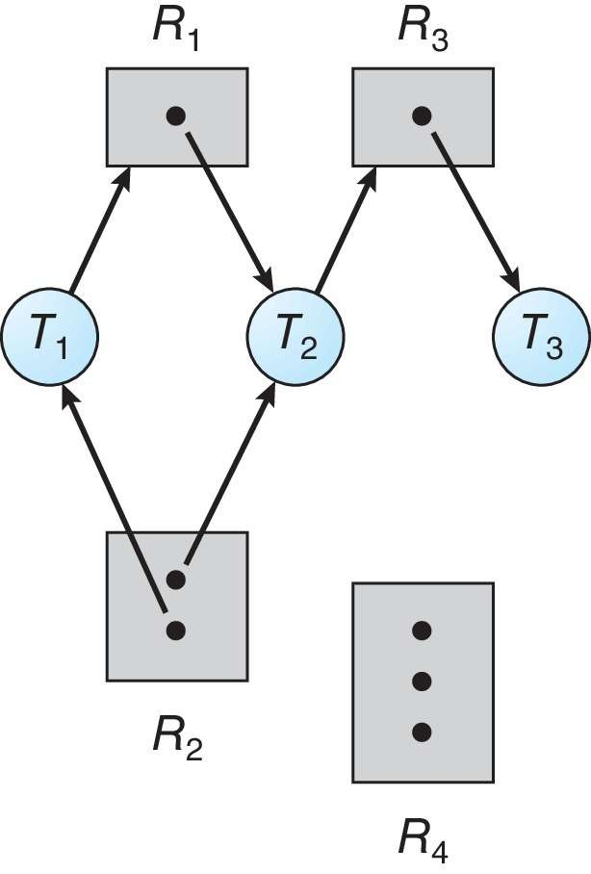
Resource Allocation Graph Example
One instance of R₁
Two instances of R₂
One instance of R₃
Three instance of R₄
T₁ holds one instance of R₂ and is waiting for an instance of R₁
T₂ holds one instance of R₁, one instance of R₂, and is waiting for an instance of R₃
T₃ is holds one instance of R₃

Slide 101
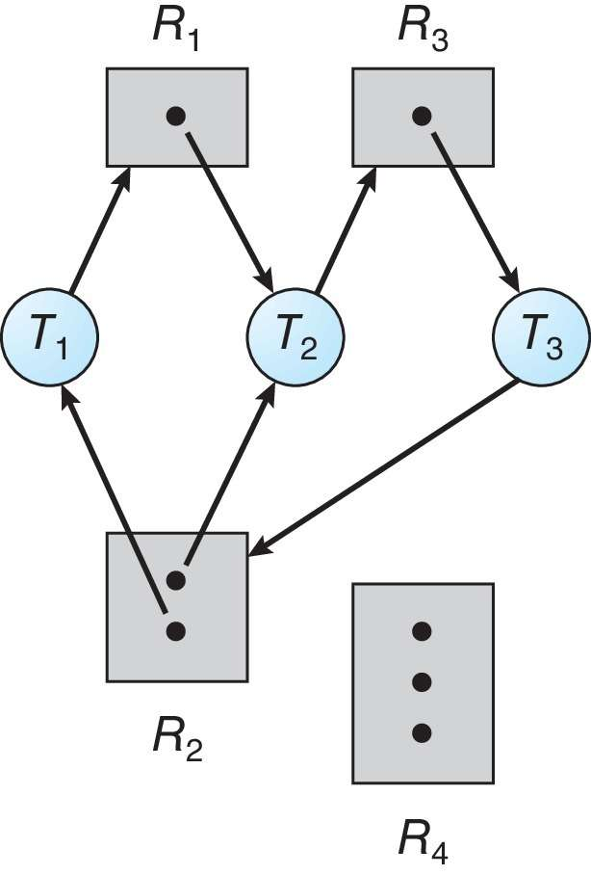
Resource Allocation Graph with a Deadlock

Slide 102
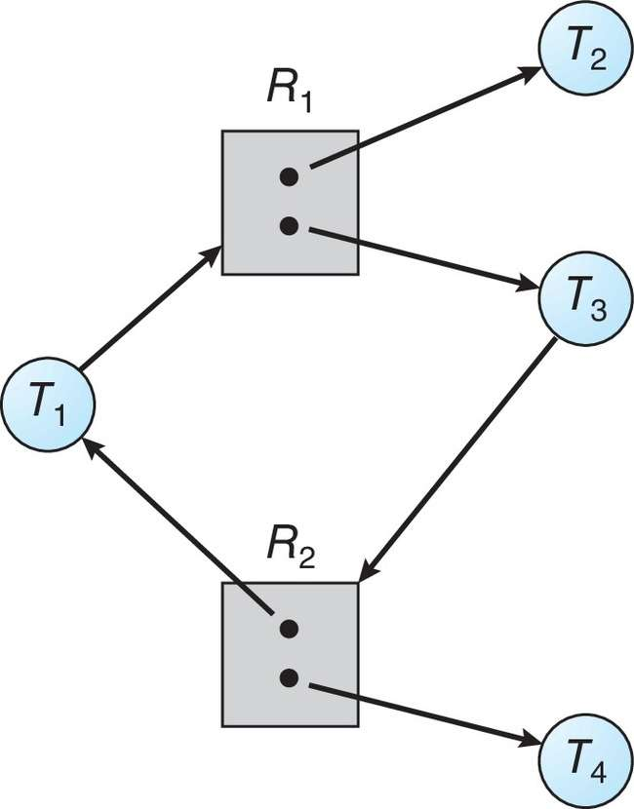
Graph with a Cycle But no Deadlock

Slide 103
Basic Facts
If graph contains no cycles ⇒ no deadlock
If graph contains a cycle ⇒
if only one instance per resource type, then deadlock
if several instances per resource type, possibility of deadlock

Slide 104
Methods for Handling Deadlocks
Ensure that the system will never enter a deadlock state:
Deadlock prevention
Deadlock avoidance
Allow the system to enter a deadlock state and then recover
Ignore the problem and pretend that deadlocks never occur in the system.

Slide 105
Deadlock Prevention
Invalidate one of the four necessary conditions for deadlock:
Mutual Exclusion – not required for sharable resources (e.g., read-only files); must hold for non-sharable resources
Hold and Wait – must guarantee that whenever a thread requests a resource, it does not hold any other resources
Require threads to request and be allocated all its resources before it begins execution or allow thread to request resources only when the thread has none allocated to it.
Low resource utilization; starvation possible

Slide 106
Deadlock Prevention (Cont.)
No Preemption:
If a process that is holding some resources requests another resource that cannot be immediately allocated to it, then all resources currently being held are released
Preempted resources are added to the list of resources for which the thread is waiting
Thread will be restarted only when it can regain its old resources, as well as the new ones that it is requesting
Circular Wait:
Impose a total ordering of all resource types, and require that each thread requests resources in an increasing order of enumeration

Slide 107
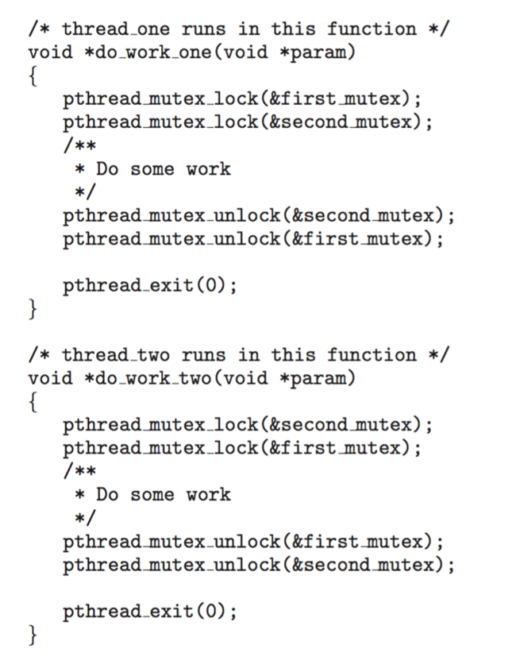
Circular Wait
Invalidating the circular wait condition is most common.
Simply assign each resource (i.e., mutex locks) a unique number.
Resources must be acquired in order.
If: first_mutex = 1 second_mutex = 5 code for thread_two could not be written as follows:

Slide 108
Deadlock Avoidance
Requires that the system has some additional a priori information available
Simplest and most useful model requires that each thread declare the maximum number of resources of each type that it may need
The deadlock-avoidance algorithm dynamically examines the resource-allocation state to ensure that there can never be a circular-wait condition
Resource-allocation state is defined by the number of available and allocated resources, and the maximum demands of the processes

Slide 109
Safe State
When a thread requests an available resource, system must decide if immediate allocation leaves the system in a safe state
System is in safe state if there exists a sequence <T₁, T₂, …, T_{n}> of ALL the threads in the systems such that for each T_{i}, the resources that T_{i} can still request can be satisfied by currently available resources + resources held by all the T_{j}, with j < I
That is:
If T_{i} resource needs are not immediately available, then T_{i} can wait until all T_{j} have finished
When T_{j} is finished, T_{i} can obtain needed resources, execute, return allocated resources, and terminate
When T_{i} terminates, T_{i +1} can obtain its needed resources, and so on

Slide 110
Basic Facts
If a system is in safe state ⇒ no deadlocks
If a system is in unsafe state ⇒ possibility of deadlock
Avoidance ⇒ ensure that a system will never enter an unsafe state.

Slide 111
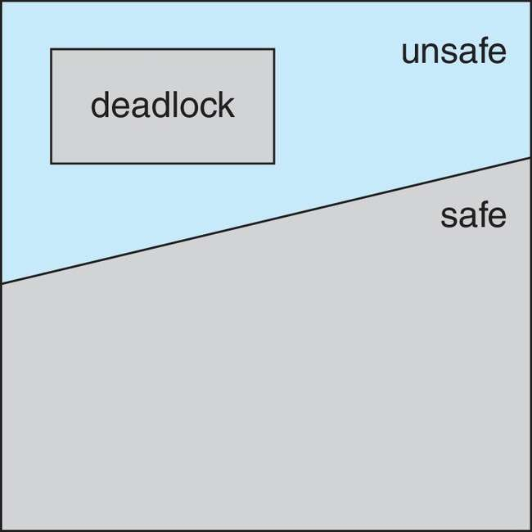
Safe, Unsafe, Deadlock State

Slide 112
Avoidance Algorithms
Single instance of a resource type
Use a resource-allocation graph
Multiple instances of a resource type
Use the Banker’s Algorithm

Slide 113
Banker’s Algorithm
Multiple instances of resources
Each thread must a priori claim maximum use
When a thread requests a resource, it may have to wait
When a thread gets all its resources it must return them in a finite amount of time

Slide 114
Example : Banker’s Algorithm
Considering a system with five processes P0 through P4 and three resources types A, B, C. Resource type A has 5 instances, B has 10 instances and C has 7 instances. Suppose at time t₀ following snapshot of the system has been taken:
By applying banker’s algorithm
What will be the content of need matrix?
Is the system in safe state? If yes, then what is the safe sequence?
Step 1:
i) Need = Max – Alloc
Step 2:
Work = Available = [ 3, 3, 2]
Finish (i)= [ F, F, F, F, F]
Step 3:
ii) System is in safe state, and the safe sequence is: P1➔P3➔P4➔P0➔P2
Process | Allocation |  |  | Max |  |  | Available
 | A | B | C | A | B | C | A | B | C
P0 | 1 | 0 | 0 | 5 | 7 | 3 | 3 | 3 | 2
P1 | 0 | 2 | 0 | 2 | 3 | 2
P2 | 0 | 3 | 2 | 0 | 9 | 2
P3 | 1 | 2 | 1 | 2 | 2 | 2
P4 | 0 | 0 | 2 | 3 | 4 | 3
➔ P0 | 4 | 7 | 3
P1 | 2 | 1 | 2
P2 | 0 | 6 | 0
P3 | 1 | 0 | 1
P4 | 3 | 4 | 2
Find the process where need<=work | If so, work=work+allocation | Finish (i) = True
P1 | ➔[3,3,2] + [0,2,0] ➔[ 3, 5, 2] | [ F, T, F, F, F]
P3 | ➔[3,5,2] + [1, 2, 1] ➔ [4,7,3] | [ F, T, F, T, F]
P4 | ➔[4,7,3] + [0,0,2] ➔ [4,7,5] | [ F, T, F, T, T]
P0 | ➔[4,7,5] + [1,0,0] ➔[5,7,5] | [ T, T, F, T, T]
P2 | ➔[5,7,5] + [0,3,2] ➔[5,10,7] | [ T, T, T, T, T]

Slide 115
Deadlock Detection
Allow system to enter deadlock state
Detection algorithm
Recovery scheme

Slide 116
Example of Detection Algorithm
Five threads T₀ through T₄; three resource types A (7 instances), B (2 instances), and C (6 instances)
Snapshot at time T₀:
Allocation Request Available
A B C A B C A B C
T₀ 0 1 0 0 0 0 0 0 0
T₁ 2 0 0 2 0 2
T₂ 3 0 3 0 0 0
T₃ 2 1 1 1 0 0
T₄ 0 0 2 0 0 2
Sequence <T₀, T₂, T₃, T₁, T₄> will result in Finish[i] = true for all i

Slide 117
Example (Cont.)
T₂ requests an additional instance of type C
Request
A B C
T₀ 0 0 0
T₁ 2 0 2
T₂ 0 0 1
T₃ 1 0 0
T₄ 0 0 2
State of system?
Can reclaim resources held by thread T₀, but insufficient resources to fulfill other processes; requests
Deadlock exists, consisting of processes T₁, T₂, T₃, and T₄

Slide 118
Recovery from Deadlock: Process Termination
Abort all deadlocked threads
Abort one process at a time until the deadlock cycle is eliminated
In which order should we choose to abort?
Priority of the thread
How long has the thread computed, and how much longer to completion
Resources that the thread has used
Resources that the thread needs to complete
How many threads will need to be terminated
Is the thread interactive or batch?

Slide 119
Recovery from Deadlock: Resource Preemption
Selecting a victim – minimize cost
Rollback – return to some safe state, restart the thread for that state
Starvation – same thread may always be picked as victim, include number of rollback in cost factor

Slide 120
Chapter 5: Memory Management (Main Memory)

Slide 121
Chapter 5: Memory Management
Background
Contiguous Memory Allocation
Paging
Structure of the Page Table
Swapping

Slide 122
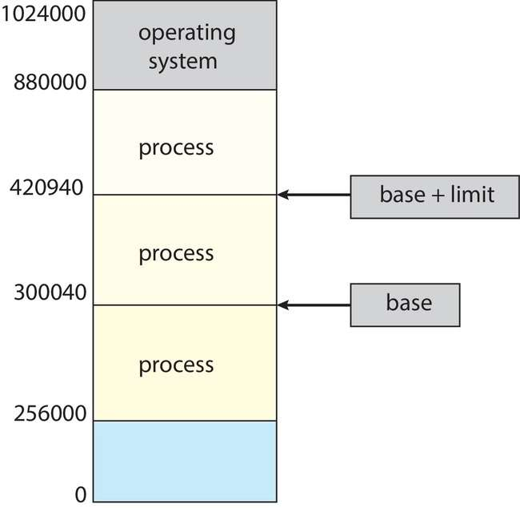
Protection
Need to ensure that a process can access only those addresses in its address space.
We can provide this protection by using a pair of base and limit registers define the logical address space of a process

Slide 123
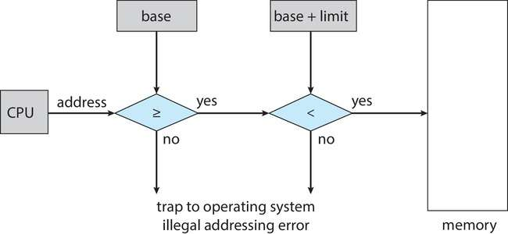
Hardware Address Protection
CPU must check every memory access generated in user mode to be sure it is between base and limit for that user
the instructions to loading the base and limit registers are privileged

Slide 124
Address Binding
Programs on disk, ready to be brought into memory to execute form an input queue
Without support, must be loaded into address 0000
Inconvenient to have first user process physical address always at 0000
How can it not be?
Addresses represented in different ways at different stages of a program’s life
Source code addresses usually symbolic
Compiled code addresses bind to relocatable addresses
i.e., “14 bytes from beginning of this module”
Linker or loader will bind relocatable addresses to absolute addresses
i.e., 74014
Each binding maps one address space to another

Slide 125
Binding of Instructions and Data to Memory
Address binding of instructions and data to memory addresses can happen at three different stages
Compile time: If memory location known a priori, absolute code can be generated; must recompile code if starting location changes
Load time: Must generate relocatable code if memory location is not known at compile time
Execution time: Binding delayed until run time if the process can be moved during its execution from one memory segment to another
Need hardware support for address maps (e.g., base and limit registers)

Slide 126
Logical vs. Physical Address Space
The concept of a logical address space that is bound to a separate physical address space is central to proper memory management
Logical address – generated by the CPU; also referred to as virtual address
Physical address – address seen by the memory unit
Logical and physical addresses are the same in compile-time and load-time address-binding schemes; logical (virtual) and physical addresses differ in execution-time address-binding scheme
Logical address space is the set of all logical addresses generated by a program
Physical address space is the set of all physical addresses generated by a program

Slide 127
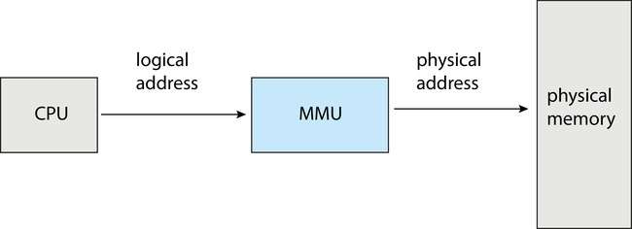
Memory-Management Unit (MMU)
Hardware device that at run time maps virtual to physical address
Many methods possible, covered in the rest of this chapter

Slide 128
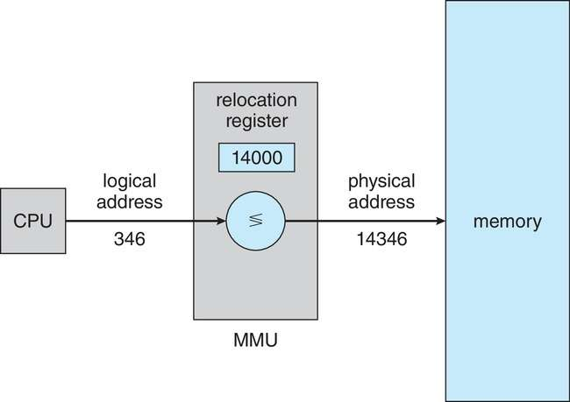
Memory-Management Unit (Cont.)
Consider simple scheme. which is a generalization of the base-register scheme.
The base register now called relocation register
The value in the relocation register is added to every address generated by a user process at the time it is sent to memory

Slide 129
Dynamic Loading
The entire program does need to be in memory to execute
Routine is not loaded until it is called
Better memory-space utilization; unused routine is never loaded
All routines kept on disk in relocatable load format
Useful when large amounts of code are needed to handle infrequently occurring cases
No special support from the operating system is required
Implemented through program design
OS can help by providing libraries to implement dynamic loading

Slide 130
Dynamic Linking
Static linking – system libraries and program code combined by the loader into the binary program image
Dynamic linking –linking postponed until execution time
Small piece of code, stub, used to locate the appropriate memory-resident library routine
Stub replaces itself with the address of the routine, and executes the routine
Operating system checks if routine is in processes’ memory address
If not in address space, add to address space
Dynamic linking is particularly useful for libraries
System also known as shared libraries
Consider applicability to patching system libraries
Versioning may be needed

Slide 131
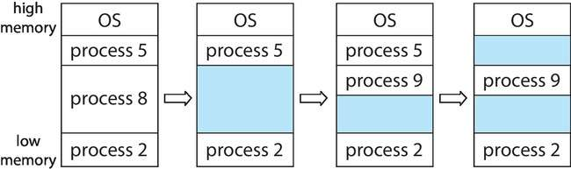
Variable Partition
Multiple-partition allocation
Degree of multiprogramming limited by number of partitions
Variable-partition sizes for efficiency (sized to a given process’ needs)
Hole – block of available memory; holes of various size are scattered throughout memory
When a process arrives, it is allocated memory from a hole large enough to accommodate it
Process exiting frees its partition, adjacent free partitions combined
Operating system maintains information about: a) allocated partitions b) free partitions (hole)

Slide 132
Dynamic Storage-Allocation Problem
How to satisfy a request of size n from a list of free holes?
First-fit: Allocate the first hole that is big enough
Best-fit: Allocate the smallest hole that is big enough; must search entire list, unless ordered by size
Produces the smallest leftover hole
Worst-fit: Allocate the largest hole; must also search entire list
Produces the largest leftover hole
First-fit and best-fit better than worst-fit in terms of speed and storage utilization

Slide 133
Fragmentation
External Fragmentation – total memory space exists to satisfy a request, but it is not contiguous
Internal Fragmentation – allocated memory may be slightly larger than requested memory; this size difference is memory internal to a partition, but not being used
First fit analysis reveals that given N blocks allocated, 0.5 N blocks lost to fragmentation
1/3 may be unusable -> 50-percent rule

Slide 134
Paging
Physical address space of a process can be noncontiguous; process is allocated physical memory whenever the latter is available
Avoids external fragmentation
Avoids problem of varying sized memory chunks
Divide physical memory into fixed-sized blocks called frames
Size is power of 2, between 512 bytes and 16 Mbytes
Divide logical memory into blocks of same size called pages
Keep track of all free frames
To run a program of size N pages, need to find N free frames and load program
Set up a page table to translate logical to physical addresses
Backing store likewise split into pages
Still have Internal fragmentation

Slide 135
Address Translation Scheme
Address generated by CPU is divided into:
Page number (p) – used as an index into a page table which contains base address of each page in physical memory
Page offset (d) – combined with base address to define the physical memory address that is sent to the memory unit
For given logical address space 2^{m} and page size 2^{n}

Slide 136
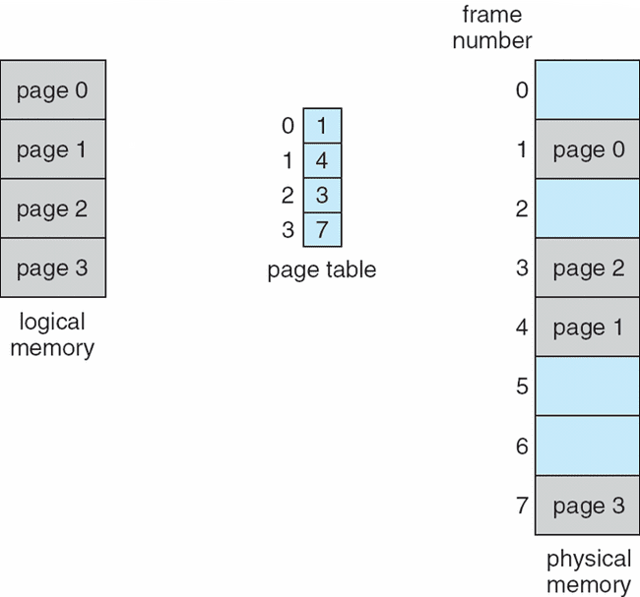
Paging Model of Logical and Physical Memory

Slide 137
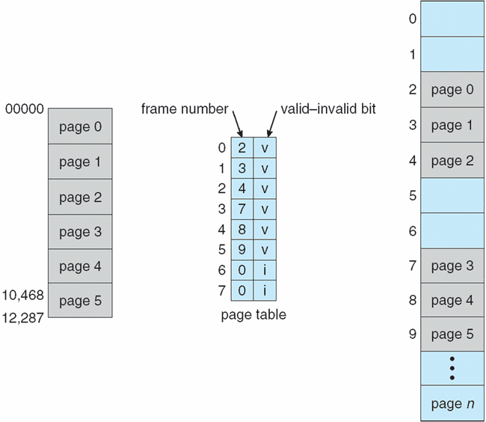
Valid (v) or Invalid (i) Bit In A Page Table

Slide 138
Swapping
A process can be swapped temporarily out of memory to a backing store, and then brought back into memory for continued execution
Total physical memory space of processes can exceed physical memory
Backing store – fast disk large enough to accommodate copies of all memory images for all users; must provide direct access to these memory images
Roll out, roll in – swapping variant used for priority-based scheduling algorithms; lower-priority process is swapped out so higher-priority process can be loaded and executed
Major part of swap time is transfer time; total transfer time is directly proportional to the amount of memory swapped
System maintains a ready queue of ready-to-run processes which have memory images on disk

Slide 139
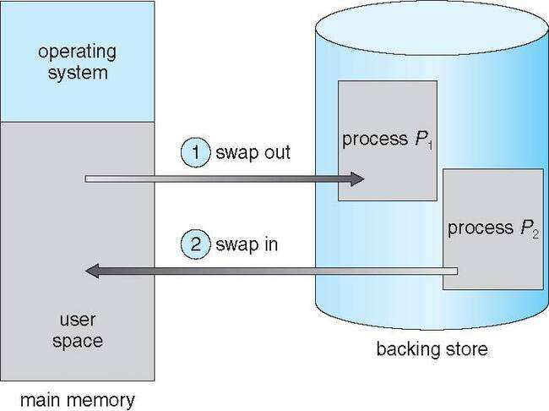
Schematic View of Swapping

Slide 140
Chapter 5 (Cont’d): Virtual Memory

Slide 141
Virtual memory
Virtual memory – separation of user logical memory from physical memory
Only part of the program needs to be in memory for execution
Logical address space can therefore be much larger than physical address space
Allows address spaces to be shared by several processes
Allows for more efficient process creation
More programs running concurrently
Less I/O needed to load or swap processes

Slide 142
Virtual memory (Cont.)
Virtual address space – logical view of how process is stored in memory
Usually start at address 0, contiguous addresses until end of space
Meanwhile, physical memory organized in page frames
MMU must map logical to physical
Virtual memory can be implemented via:
Demand paging
Demand segmentation

Slide 143
Demand Paging
Could bring entire process into memory at load time
Or bring a page into memory only when it is needed
Less I/O needed, no unnecessary I/O
Less memory needed
Faster response
More users
Similar to paging system with swapping (diagram on right)
Page is needed ⇒ reference to it
invalid reference ⇒ abort
not-in-memory ⇒ bring to memory
Lazy swapper – never swaps a page into memory unless page will be needed
Swapper that deals with pages is a pager

Slide 144
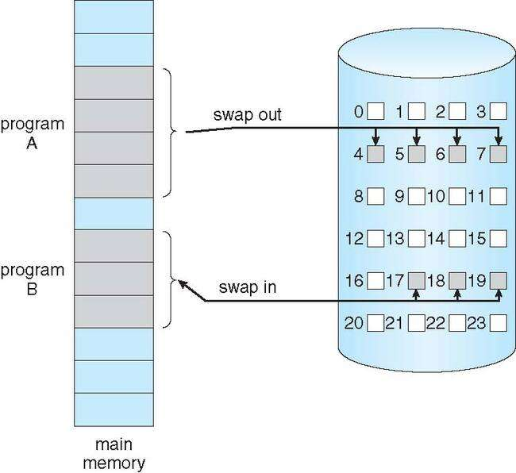
Demand Paging
Could bring entire process into memory at load time
Or bring a page into memory only when it is needed
Less I/O needed, no unnecessary I/O
Less memory needed
Faster response
More users
Similar to paging system with swapping (diagram on right)

Slide 145
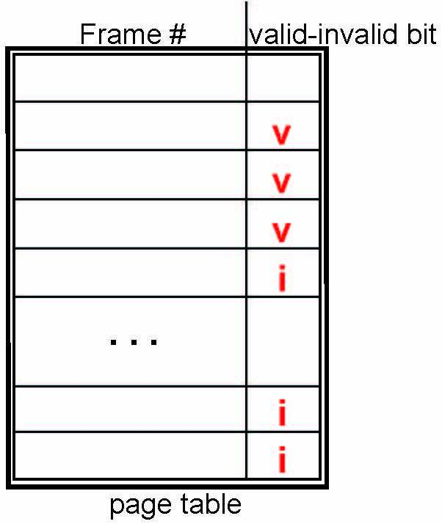
Valid-Invalid Bit
With each page table entry a valid–invalid bit is associated (v ⇒ in-memory – memory resident, i ⇒ not-in-memory)
Initially valid–invalid bit is set to i on all entries
Example of a page table snapshot:
During MMU address translation, if valid–invalid bit in page table entry is i ⇒ page fault

Slide 146
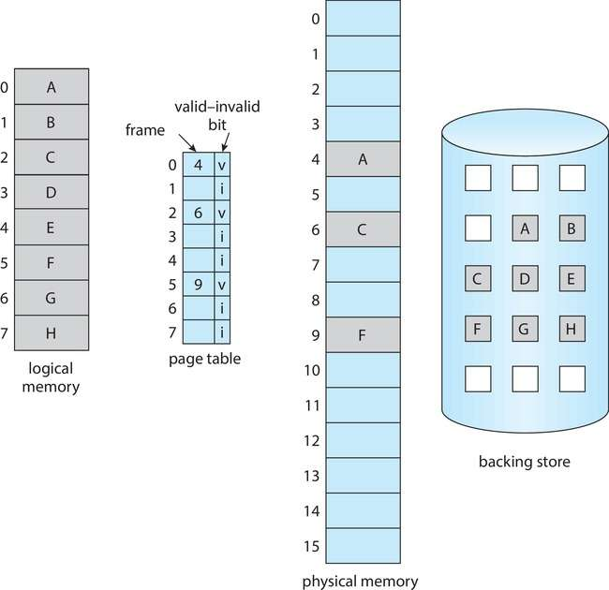
Page Table When Some Pages Are Not in Main Memory

Slide 147
Copy-on-Write
Copy-on-Write (COW) allows both parent and child processes to initially share the same pages in memory
If either process modifies a shared page, only then is the page copied
COW allows more efficient process creation as only modified pages are copied
In general, free pages are allocated from a pool of zero-fill-on-demand pages
Pool should always have free frames for fast demand page execution
Don’t want to have to free a frame as well as other processing on page fault
Why zero-out a page before allocating it?
vfork() variation on fork() system call has parent suspend and child using copy-on-write address space of parent
Designed to have child call exec()
Very efficient

Slide 148
Basic Page Replacement
Find the location of the desired page on disk
Find a free frame: - If there is a free frame, use it - If there is no free frame, use a page replacement algorithm to select a victim frame - Write victim frame to disk if dirty
Bring the desired page into the (newly) free frame; update the page and frame tables
Continue the process by restarting the instruction that caused the trap
Note now potentially 2 page transfers for page fault – increasing EAT

Slide 149
Page and Frame Replacement Algorithms
Frame-allocation algorithm determines
How many frames to give each process
Which frames to replace
Page-replacement algorithm
Want lowest page-fault rate on both first access and re-access
Evaluate algorithm by running it on a particular string of memory references (reference string) and computing the number of page faults on that string
String is just page numbers, not full addresses
Repeated access to the same page does not cause a page fault
Results depend on number of frames available
In all our examples, the reference string of referenced page numbers is
7,0,1,2,0,3,0,4,2,3,0,3,0,3,2,1,2,0,1,7,0,1

Slide 150

Graph of Page Faults Versus the Number of Frames

Slide 151

First-In-First-Out (FIFO) Algorithm
Reference string: 7,0,1,2,0,3,0,4,2,3,0,3,0,3,2,1,2,0,1,7,0,1
3 frames (3 pages can be in memory at a time per process)
Can vary by reference string: consider 1,2,3,4,1,2,5,1,2,3,4,5
Adding more frames can cause more page faults!
Belady’s Anomaly
How to track ages of pages?
Just use a FIFO queue
15 page faults

Slide 152
FIFO Illustrating Belady’s Anomaly

Slide 153

Optimal Algorithm
Replace page that will not be used for longest period of time
9 is optimal for the example
How do you know this?
Can’t read the future
Used for measuring how well your algorithm performs

Slide 154

Least Recently Used (LRU) Algorithm
Use past knowledge rather than future
Replace page that has not been used in the most amount of time
Associate time of last use with each page
12 faults – better than FIFO but worse than OPT
Generally good algorithm and frequently used
But how to implement?

Slide 155
LRU Algorithm (Cont.)
Counter implementation
Every page entry has a counter; every time page is referenced through this entry, copy the clock into the counter
When a page needs to be changed, look at the counters to find smallest value
Search through table needed
Stack implementation
Keep a stack of page numbers in a double link form:
Page referenced:
move it to the top
requires 6 pointers to be changed
But each update more expensive
No search for replacement

Slide 156
LRU Algorithm (Cont.)
LRU and OPT are cases of stack algorithms that don’t have Belady’s Anomaly
Use Of A Stack to Record Most Recent Page References

Slide 157
Thrashing
If a process does not have “enough” pages, the page-fault rate is very high
Page fault to get page
Replace existing frame
But quickly need replaced frame back
This leads to:
Low CPU utilization
Operating system thinking that it needs to increase the degree of multiprogramming
Another process added to the system

Slide 158

Thrashing (Cont.)
Thrashing. A process is busy swapping pages in and out

Slide 159
Chapter 6: File Management

Slide 160
Outline
File Concept
Access Methods
Disk and Directory Structure
Protection
Memory-Mapped Files

Slide 161
File Concept
Contiguous logical address space
Types:
Data
Numeric
Character
Binary
Program
Contents defined by file’s creator
Many types
text file,
source file,
executable file

Slide 162
File Attributes
Name – only information kept in human-readable form
Identifier – unique tag (number) identifies file within file system
Type – needed for systems that support different types
Location – pointer to file location on device
Size – current file size
Protection – controls who can do reading, writing, executing
Time, date, and user identification – data for protection, security, and usage monitoring
Information about files are kept in the directory structure, which is maintained on the disk
Many variations, including extended file attributes such as file checksum
Information kept in the directory structure

Slide 163
File Operations
Create
Write – at write pointer location
Read – at read pointer location
Reposition within file - seek
Delete
Truncate
Open (F_{i}) – search the directory structure on disk for entry F_{i}, and move the content of entry to memory
Close (F_{i}) – move the content of entry F_{i} in memory to directory structure on disk

Slide 164
File Locking
Provided by some operating systems and file systems
Similar to reader-writer locks
Shared lock similar to reader lock – several processes can acquire concurrently
Exclusive lock similar to writer lock
Mediates access to a file
Mandatory or advisory:
Mandatory – access is denied depending on locks held and requested
Advisory – processes can find status of locks and decide what to do

Slide 165
File Structure
None - sequence of words, bytes
Simple record structure
Lines
Fixed length
Variable length
Complex Structures
Formatted document
Relocatable load file
Can simulate last two with first method by inserting appropriate control characters
Who decides:
Operating system
Program

Slide 166
Access Methods
A file is fixed length logical records
Sequential Access
Direct Access
Other Access Methods

Slide 167

Sequential Access
Operations
read next
write next
Reset
no read after last write (rewrite)
Figure

Slide 168
Direct Access
Operations
read n
write n
position to n
read next
write next
rewrite n
n = relative block number
Relative block numbers allow OS to decide where file should be placed

Slide 169
Disk Structure
Disk can be subdivided into partitions
Disks or partitions can be RAID protected against failure
Disk or partition can be used raw – without a file system, or formatted with a file system
Partitions also known as minidisks, slices
Entity containing file system is known as a volume
Each volume containing a file system also tracks that file system’s info in device directory or volume table of contents
In addition to general-purpose file systems there are many special-purpose file systems, frequently all within the same operating system or computer

Slide 170

A Typical File-system Organization

Slide 171
Directory Structure
A collection of nodes containing information about all files
Both the directory structure and the files reside on disk

Slide 172
Operations Performed on Directory
Search for a file
Create a file
Delete a file
List a directory
Rename a file
Traverse the file system

Slide 173
Directory Organization
The directory is organized logically to obtain
Efficiency – locating a file quickly
Naming – convenient to users
Two users can have same name for different files
The same file can have several different names
Grouping – logical grouping of files by properties, (e.g., all Java programs, all games, …)

Slide 174

Single-Level Directory
A single directory for all users
Naming problem
Grouping problem

Slide 175

Two-Level Directory
Separate directory for each user
Path name
Can have the same file name for different user
Efficient searching
No grouping capability

Slide 176

Current Directory
Can designate one of the directories as the current (working) directory
cd /spell/mail/prog
type list
Creating and deleting a file is done in current directory
Example of creating a new file
If in current directory is /mail
The command
mkdir <dir-name>
Results in:
Deleting “mail” ⇒ deleting the entire subtree rooted by “mail”

Slide 177
Protection
File owner/creator should be able to control:
What can be done
By whom
Types of access
Read
Write
Execute
Append
Delete
List

Slide 178
Chapter 6 (Cont’d): File System Implementation

Slide 179
File-System Structure
File structure
Logical storage unit
Collection of related information
File system resides on secondary storage (disks)
Provided user interface to storage, mapping logical to physical
Provides efficient and convenient access to disk by allowing data to be stored, located retrieved easily
Disk provides in-place rewrite and random access
I/O transfers performed in blocks of sectors (usually 512 bytes)
File control block (FCB) – storage structure consisting of information about a file
Device driver controls the physical device
File system organized into layers

Slide 180

Layered File System

Slide 181
File System Layers
Device drivers manage I/O devices at the I/O control layer
Given commands like
read drive1, cylinder 72, track 2, sector 10, into memory location 1060
Outputs low-level hardware specific commands to hardware controller
Basic file system given command like “retrieve block 123” translates to device driver
Also manages memory buffers and caches (allocation, freeing, replacement)
Buffers hold data in transit
Caches hold frequently used data
File organization module understands files, logical address, and physical blocks
Translates logical block # to physical block #
Manages free space, disk allocation

Slide 182
File System Layers (Cont.)
Logical file system manages metadata information
Translates file name into file number, file handle, location by maintaining file control blocks (inodes in UNIX)
Directory management
Protection
Layering useful for reducing complexity and redundancy, but adds overhead and can decrease performance
Logical layers can be implemented by any coding method according to OS designer

Slide 183
Allocation Method
An allocation method refers to how disk blocks are allocated for files:
Contiguous
Linked
File Allocation Table (FAT)

Slide 184
Contiguous Allocation Method
An allocation method refers to how disk blocks are allocated for files:
Each file occupies set of contiguous blocks
Best performance in most cases
Simple – only starting location (block #) and length (number of blocks) are required
Problems include:
Finding space on the disk for a file,
Knowing file size,
External fragmentation, need for compaction off-line (downtime) or on-line

Slide 185

Contiguous Allocation (Cont.)
Mapping from logical to physical (block size =512 bytes)
Block to be accessed = starting address + Q
Displacement into block = R
Q
LA/512
R

Slide 186
Linked Allocation
Each file is a linked list of blocks
File ends at nil pointer
No external fragmentation
Each block contains pointer to next block
No compaction, external fragmentation
Free space management system called when new block needed
Improve efficiency by clustering blocks into groups but increases internal fragmentation
Reliability can be a problem
Locating a block can take many I/Os and disk seeks

Slide 187

Linked Allocation Example
Each file is a linked list of disk blocks: blocks may be scattered anywhere on the disk
Scheme

Slide 188
Linked Allocation (Cont.)
Mapping
Block to be accessed is the Q^{th} block in the linked chain of blocks representing the file.
Displacement into block = R + 1
Q
LA/511
R

Slide 189
FAT Allocation Method
Beginning of volume has table, indexed by block number
Much like a linked list, but faster on disk and cacheable
New block allocation simple

Slide 190

File-Allocation Table

Slide 191
Indexed Allocation Method
Each file has its own index block(s) of pointers to its data blocks
Logical view

Slide 192

Example of Indexed Allocation

Slide 193
File Sharing
Allows multiple users / systems access to the same files
Permissions / protection must be implemented and accurate
Most systems provide concepts of owner, group member
Must have a way to apply these between systems

Slide 194
Chapter 6 (Cont’d): OS Security

Slide 195
The Security Problem
System secure if resources used and accessed as intended under all circumstances
Unachievable
Intruders (crackers) attempt to breach security
Threat is potential security violation
Attack is attempt to breach security
Attack can be accidental or malicious
Easier to protect against accidental than malicious misuse

Slide 196
Security Violation Categories
Breach of confidentiality
Unauthorized reading of data
Breach of integrity
Unauthorized modification of data
Breach of availability
Unauthorized destruction of data
Theft of service
Unauthorized use of resources
Denial of service (DOS)
Prevention of legitimate use

Slide 197
Security Violation Methods
Masquerading (breach authentication)
Pretending to be an authorized user to escalate privileges
Replay attack
As is or with message modification
Man-in-the-middle attack
Intruder sits in data flow, masquerading as sender to receiver and vice versa
Session hijacking
Intercept an already-established session to bypass authentication
Privilege escalation
Common attack type with access beyond what a user or resource is supposed to have

Slide 198
Security Measure Levels
Impossible to have absolute security, but make cost to perpetrator sufficiently high to deter most intruders
Security must occur at four levels to be effective:
Physical
Data centers, servers, connected terminals
Application
Benign or malicious apps can cause security problems
Operating System
Protection mechanisms, debugging
Network
Intercepted communications, interruption, DOS
Security is as weak as the weakest link in the chain
Humans a risk too via phishing and social-engineering attacks
But can too much security be a problem?

Slide 199
End of Chapter 6

